Slide 1
How can we achieve Trade Show success?
Roberto Melisi
Sales Manager
01908 368001
Roberto.Melisi@blue-alligator.com

Slide 2
Agenda
Trade Show Success
Traffic
Engagement
Retention
Utilisation
Sales@blue-alligator.com 01908 368001

Slide 3
Traffic
It’s a numbers game!
Sales@blue-alligator.com 01908 368001

Slide 4
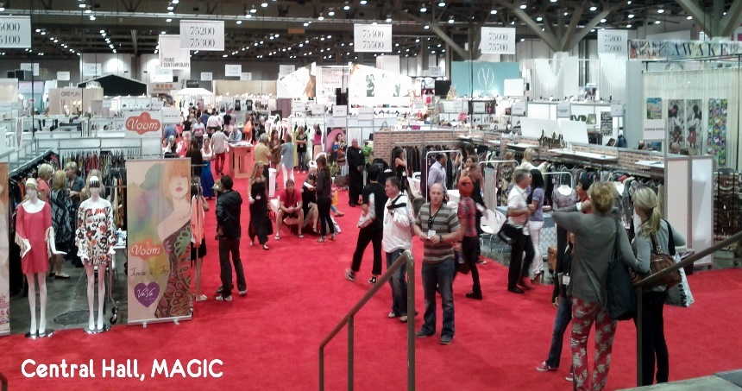
Numbers
Trade stand placement is key
Lots of smiling staff
Product Catalogues
‘If you’ve got it, flaunt it’
Sales@blue-alligator.com 01908 368001
Notes:
The first step is booking your stand and ensuring its in the best position, near a café, an entrance, even a toilet, anywhere that traffic is funnelling through.
All your staff whether its sales or reception or anyone, all staff should be at the ready to engage any and all footfall. AF not so busy this year so companies who were taking advantage stood out.

Slide 5
Gimmicks/Giveaways
Freebies
Tea/coffee
Why tangible?
Digital Catalogue (PDF)
Product images
Exclusive Whitepapers for your industry
Sales@blue-alligator.com 01908 368001
Notes:
Freebies
They work, offer vouchers for a freebie and spread the word, marketing campaigns, eshots, leaflets, have your sales people call all their customers etc etc.
Tea/coffee - Everyone loves a coffee.
Came across Swedish company, barista at their stand, entertaining and engaging

Slide 6
Engagement
Show them attention, they’ll love you for it.
Sales@blue-alligator.com 01908 368001

Slide 7
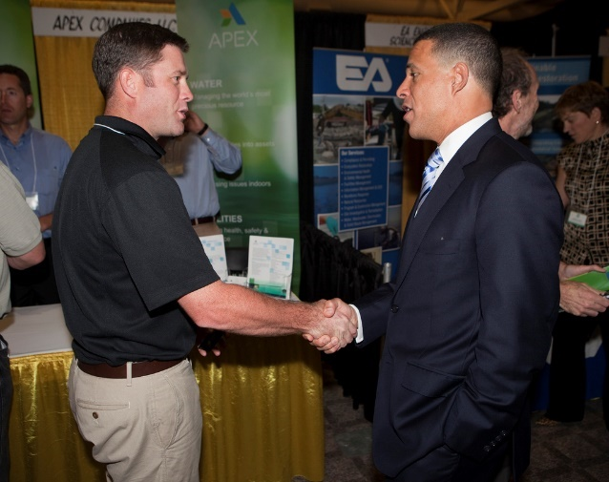
Your time limit is short!
60 secs!
How can Blue Alligator help?
Sales@blue-alligator.com 01908 368001
Notes:
Average time a customer will spend on a stand if not engaged, before leaving – 60 seconds http://www.smetoolkit.org/smetoolkit/en/content/en/914/How-to-Sell-at-Trade-Shows
Identify a buyer within the 2 minute mark. It would be a crucial waste of time to sit with someone who has no buying power or even owns a business!
You have the numbers, now fight through mud and grit to find out the core decision makers in your traffic, quickly. Some questions:
How long has the company been going for?
What are the profit goals for your organisation?
How are you planning to achieve this?
Whats the story behind your company?
If they can answer these sorts of questions its likely they are higher in rankings, enabling you to continue the conversation.
http://nimloktradeshowmarketing.com/trade-show-leads-101-qualifying-leads/

Slide 8
Staff Attitude
55% Body Language
38% Tone of voice
7% Spoken Word
7%
55%
38%
Sales@blue-alligator.com 01908 368001
Notes:
Engage them with your products and all the information you have
Show them information as often as you can
Smile, be positive, show openness.
Business owners ensure your staff are trained. Send links from this presentation
https://blog.udemy.com/positive-body-language

Slide 9
Old School vs. New School
Paper Orders
‘It works for us’
Missing Opportunities?
Making mistakes
Not engaging your customer
Where am i? ‘get your calculator out’!
SalesPresenter
More attention on customer
Utilise barcode scanning (more details coming up)
The next step in wholesale business
Upsell based on products of interest
VS.
Sales@blue-alligator.com 01908 368001
Notes:
Paper orders thing of the past – With larger companies taking on speedy order taking processes not only do they improve the customer experience whilst with the customer, the post order experience is also improved. And this adds to your sale.
Make use of all your tools in the kit – Batch barcode scanners and SalesPresenter’s speedy order entry will give your reps far more time to engage, spending 2 minutes talking about your prospect’s day will change everything.

Slide 10
Retention
Rapport, communication and continued relationships
Sales@blue-alligator.com 01908 368001

Slide 11
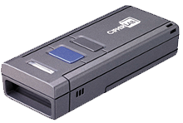
SalesPresenter Customer Retention
Missed opportunities – AGAIN!
Time is key – utilise every second
Give your customer control
How would they like to continue communication?
Web ordering availability
Sales@blue-alligator.com 01908 368001
Notes:
Once at the ordering stage, the engagement of the customer is key. Keep a convo flowing.
One key point – batch reading barcode scanning, give control to the customer and let them scan away.
Utilise the different features – show details, hand customer the scanner (both when with and when not)

Slide 12
Utilisation
Once you’ve got them keep them!
Sales@blue-alligator.com 01908 368001

Slide 13
What to do with all that data?
Create reports in seconds
Give reps the full scope of opportunity
Highlight key gaps in your business
Start in sales, broaden to your whole business
Visualise locations you are missing
Lots of orders…
Whats been sold?
Who bought the most?
Where should we be focusing our marketing attention?
What areas are now filled with our products?
Sales@blue-alligator.com 01908 368001
Notes:
Series of questions that ERP systems take a while to report on.
Business intelligence is becoming more popular highlighting missed opportunities in just a few clicks.
Great partners in place to help explore the possibilities of all the information you collect through your sales events.

Slide 14
Sales@blue-alligator.com 01908 368001 www.blue-alligator.com
Roberto.Melisi@blue-alligator.com

